Slide 1

MID – TERM PRESENTATION
MGMT 52710 (Spring 2024) – Digital Marketing Application
Group 1
Utkarsh Prabhakar Patil
Pratiksha Gupta
Mourya Gupta Vakacharla
Gina Margaret D'Cunha

Slide 2

Ad Grants
Nonprofit Marketing Immersion
Pre-Campaign Report
Dream Preparatory Academy Inc
Notes:
Pratiksha

Slide 3

Nonprofit Overview
Dream Preparatory Academy Inc
Website: www.dreamprepacademyinc.org
Cause area: Education
Location: 29 Ridgeway Dr, Greenville, SC, 29605
Organization size: 10+
Years in operation: Dec, 2022
Services or products they offer: Pre-school Weekend childcare School Day Program Extended Day
Summer Camp After school Program (Coming soon...)
Mission: To improve youth confidence through independence in a natural environment, while creating a technological impact to improve learning programs.
Notes:
Pratiksha

Slide 4
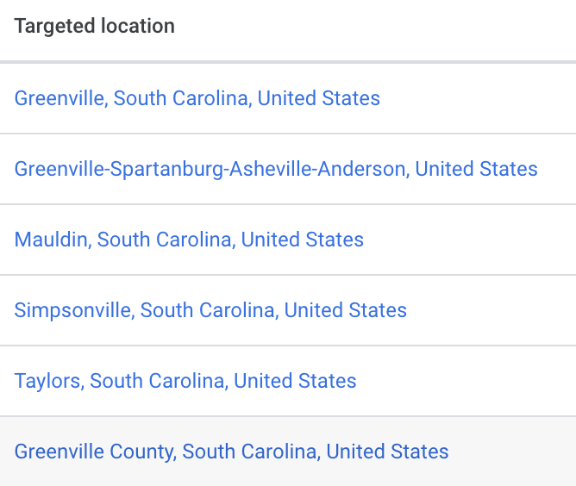
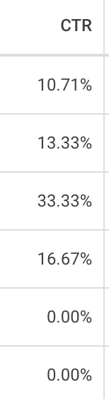

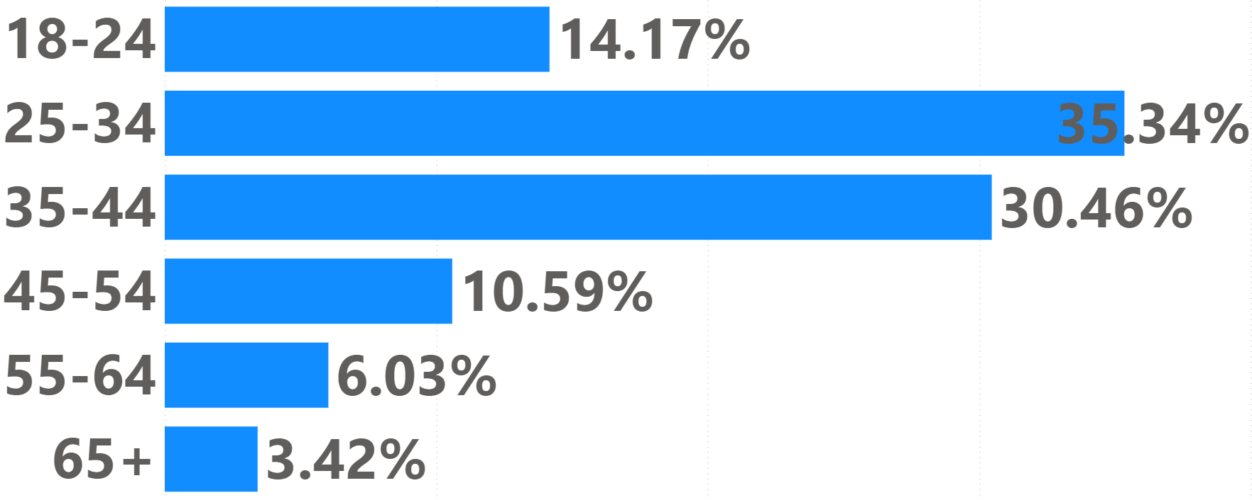

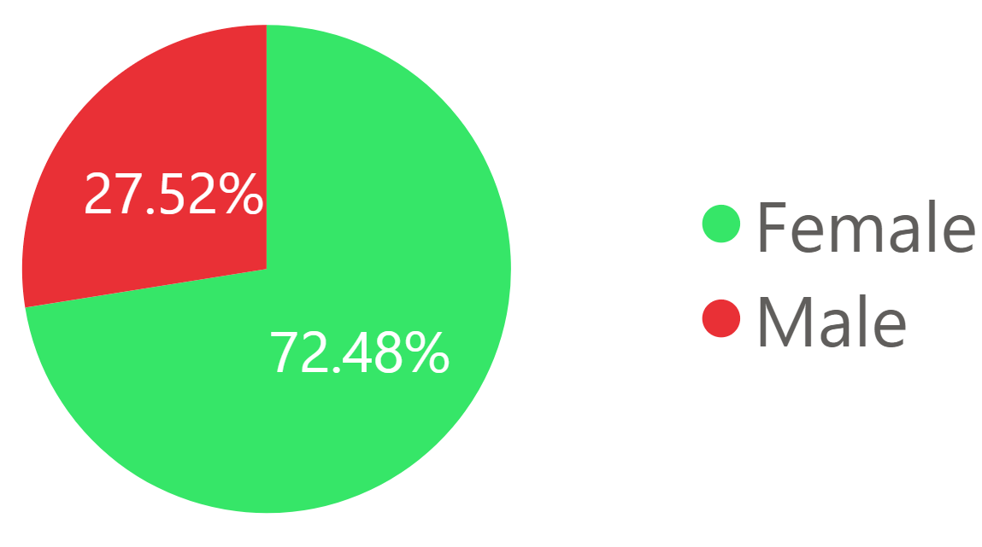


Market and Target Audience Analysis
Age
Parents with kids of age 1.5 to 5 years in and around Greenville, SC
Gender
Audiences
Notes:
Pratiksha

Slide 5

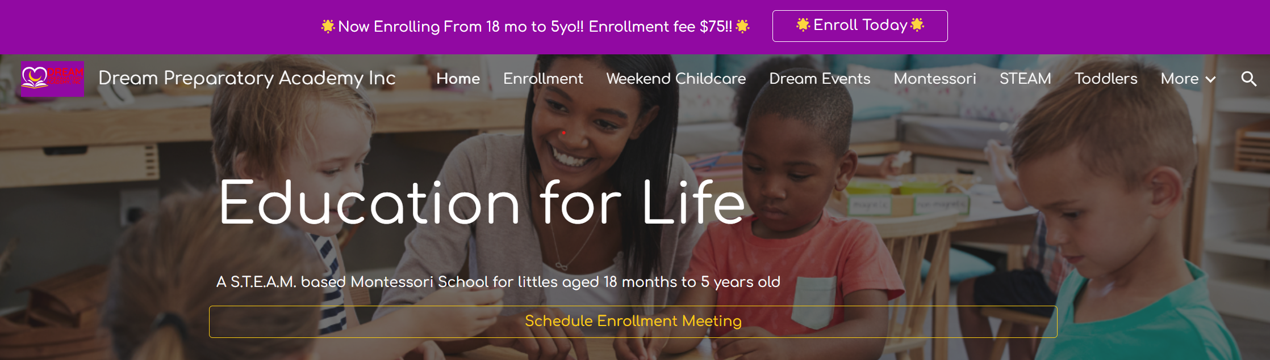
Current Marketing
Website Overview
Join Our Mission Support Our Vision Learn More Donate Volunteer
Subscribe Event Registration
Notes:
Gina Join Our Mission: Encourage visitors to be a part of improving youth confidence and independence in a natural environment.
Support Our Vision: Invite individuals to empower youth through community engagement and innovative educational approaches.
Learn More: Offer information on why the organization emphasizes more than academics, highlighting curiosity, independence, compassion, collaboration, and critical thinking.
Donate: Provide an option for visitors to contribute financially to support the organization's goals and learning programs.
Volunteer: Call for community members to sign up and volunteer for various educational and engagement initiatives.
Subscribe: Ask visitors to subscribe to the newsletter for updates on technological impacts and improvements in learning programs.
Event Registration: Enable users to buy tickets or register for upcoming events that support the educational mission.

Slide 6
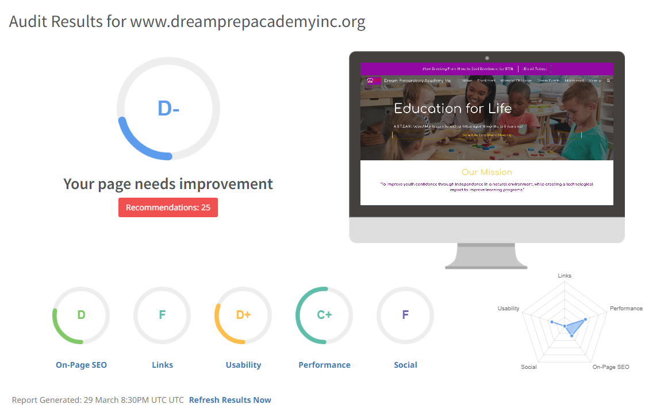

Slide 7

Webpage recommendation based on SEO analysis
Non-functional call to action

Slide 8
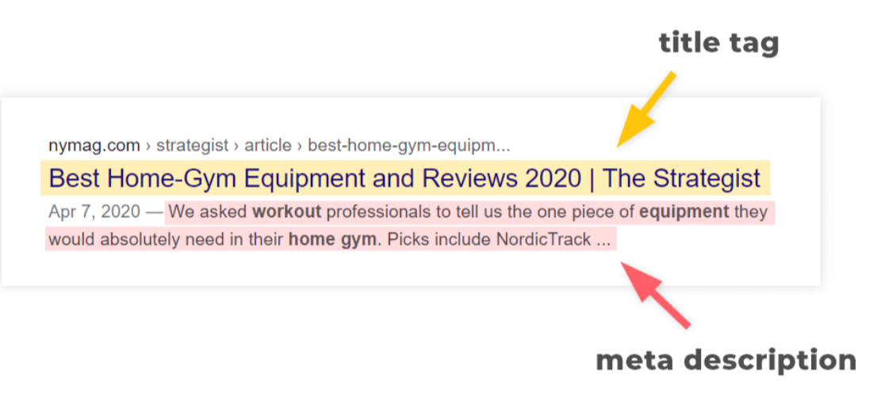
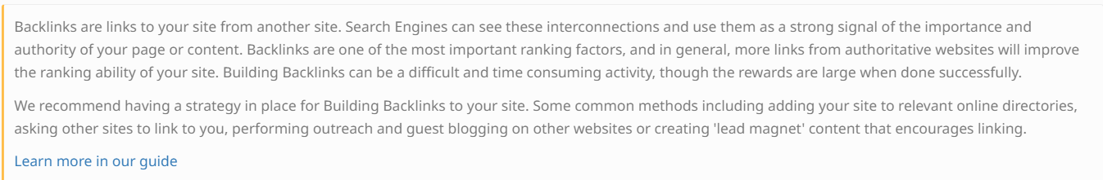
Webpage recommendation based on SEO analysis
Meta Description tag missing
Backlinks missing

Slide 9







Current Marketing
Online/Offline Marketing
Notes:
Gina What types of marketing channels do they currently use?
What types of marketing channels do they currently use?
Online Channels (Online Advertising, Video (YouTube), Blog, Email, Social (Facebook, Twitter, etc.)
They advertise through google ads
Offline channels (TV, direct mailing, newspapers & print, billboards, door-to-door, fundraising in public areas, event marketing etc.)

Slide 10
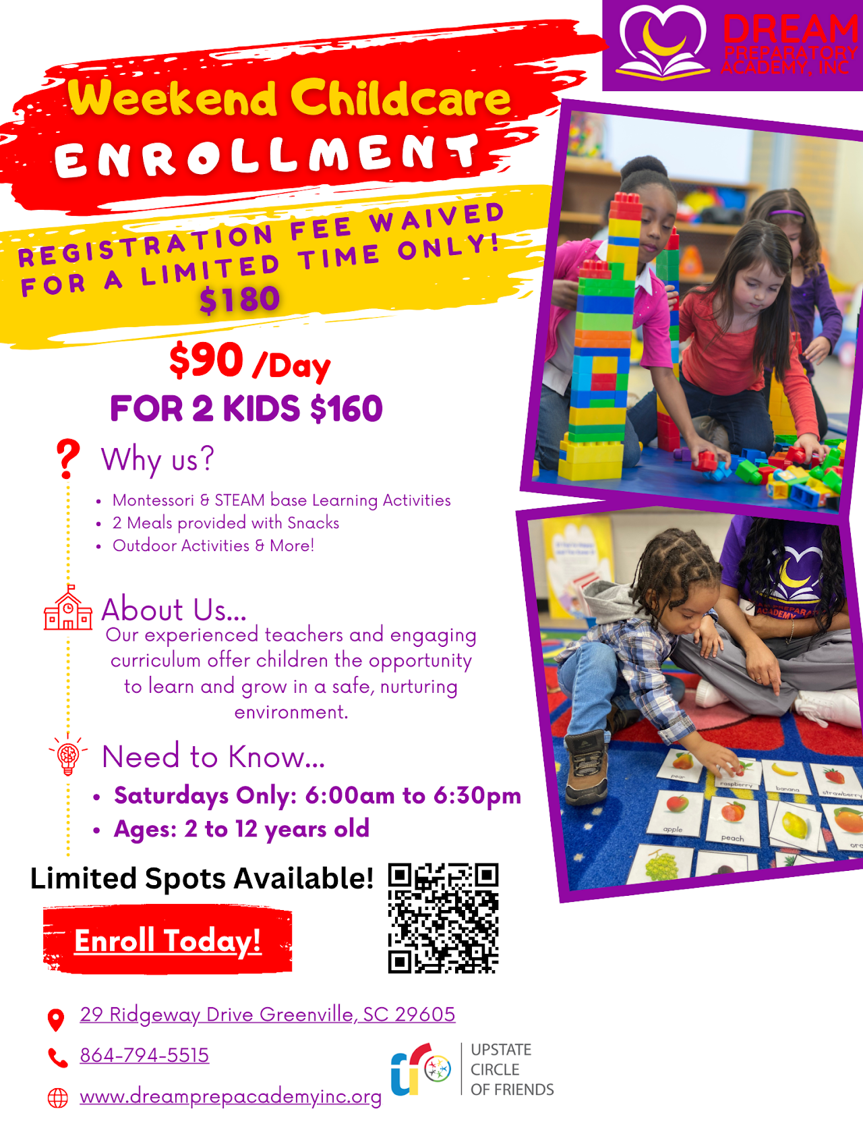


Slide 11
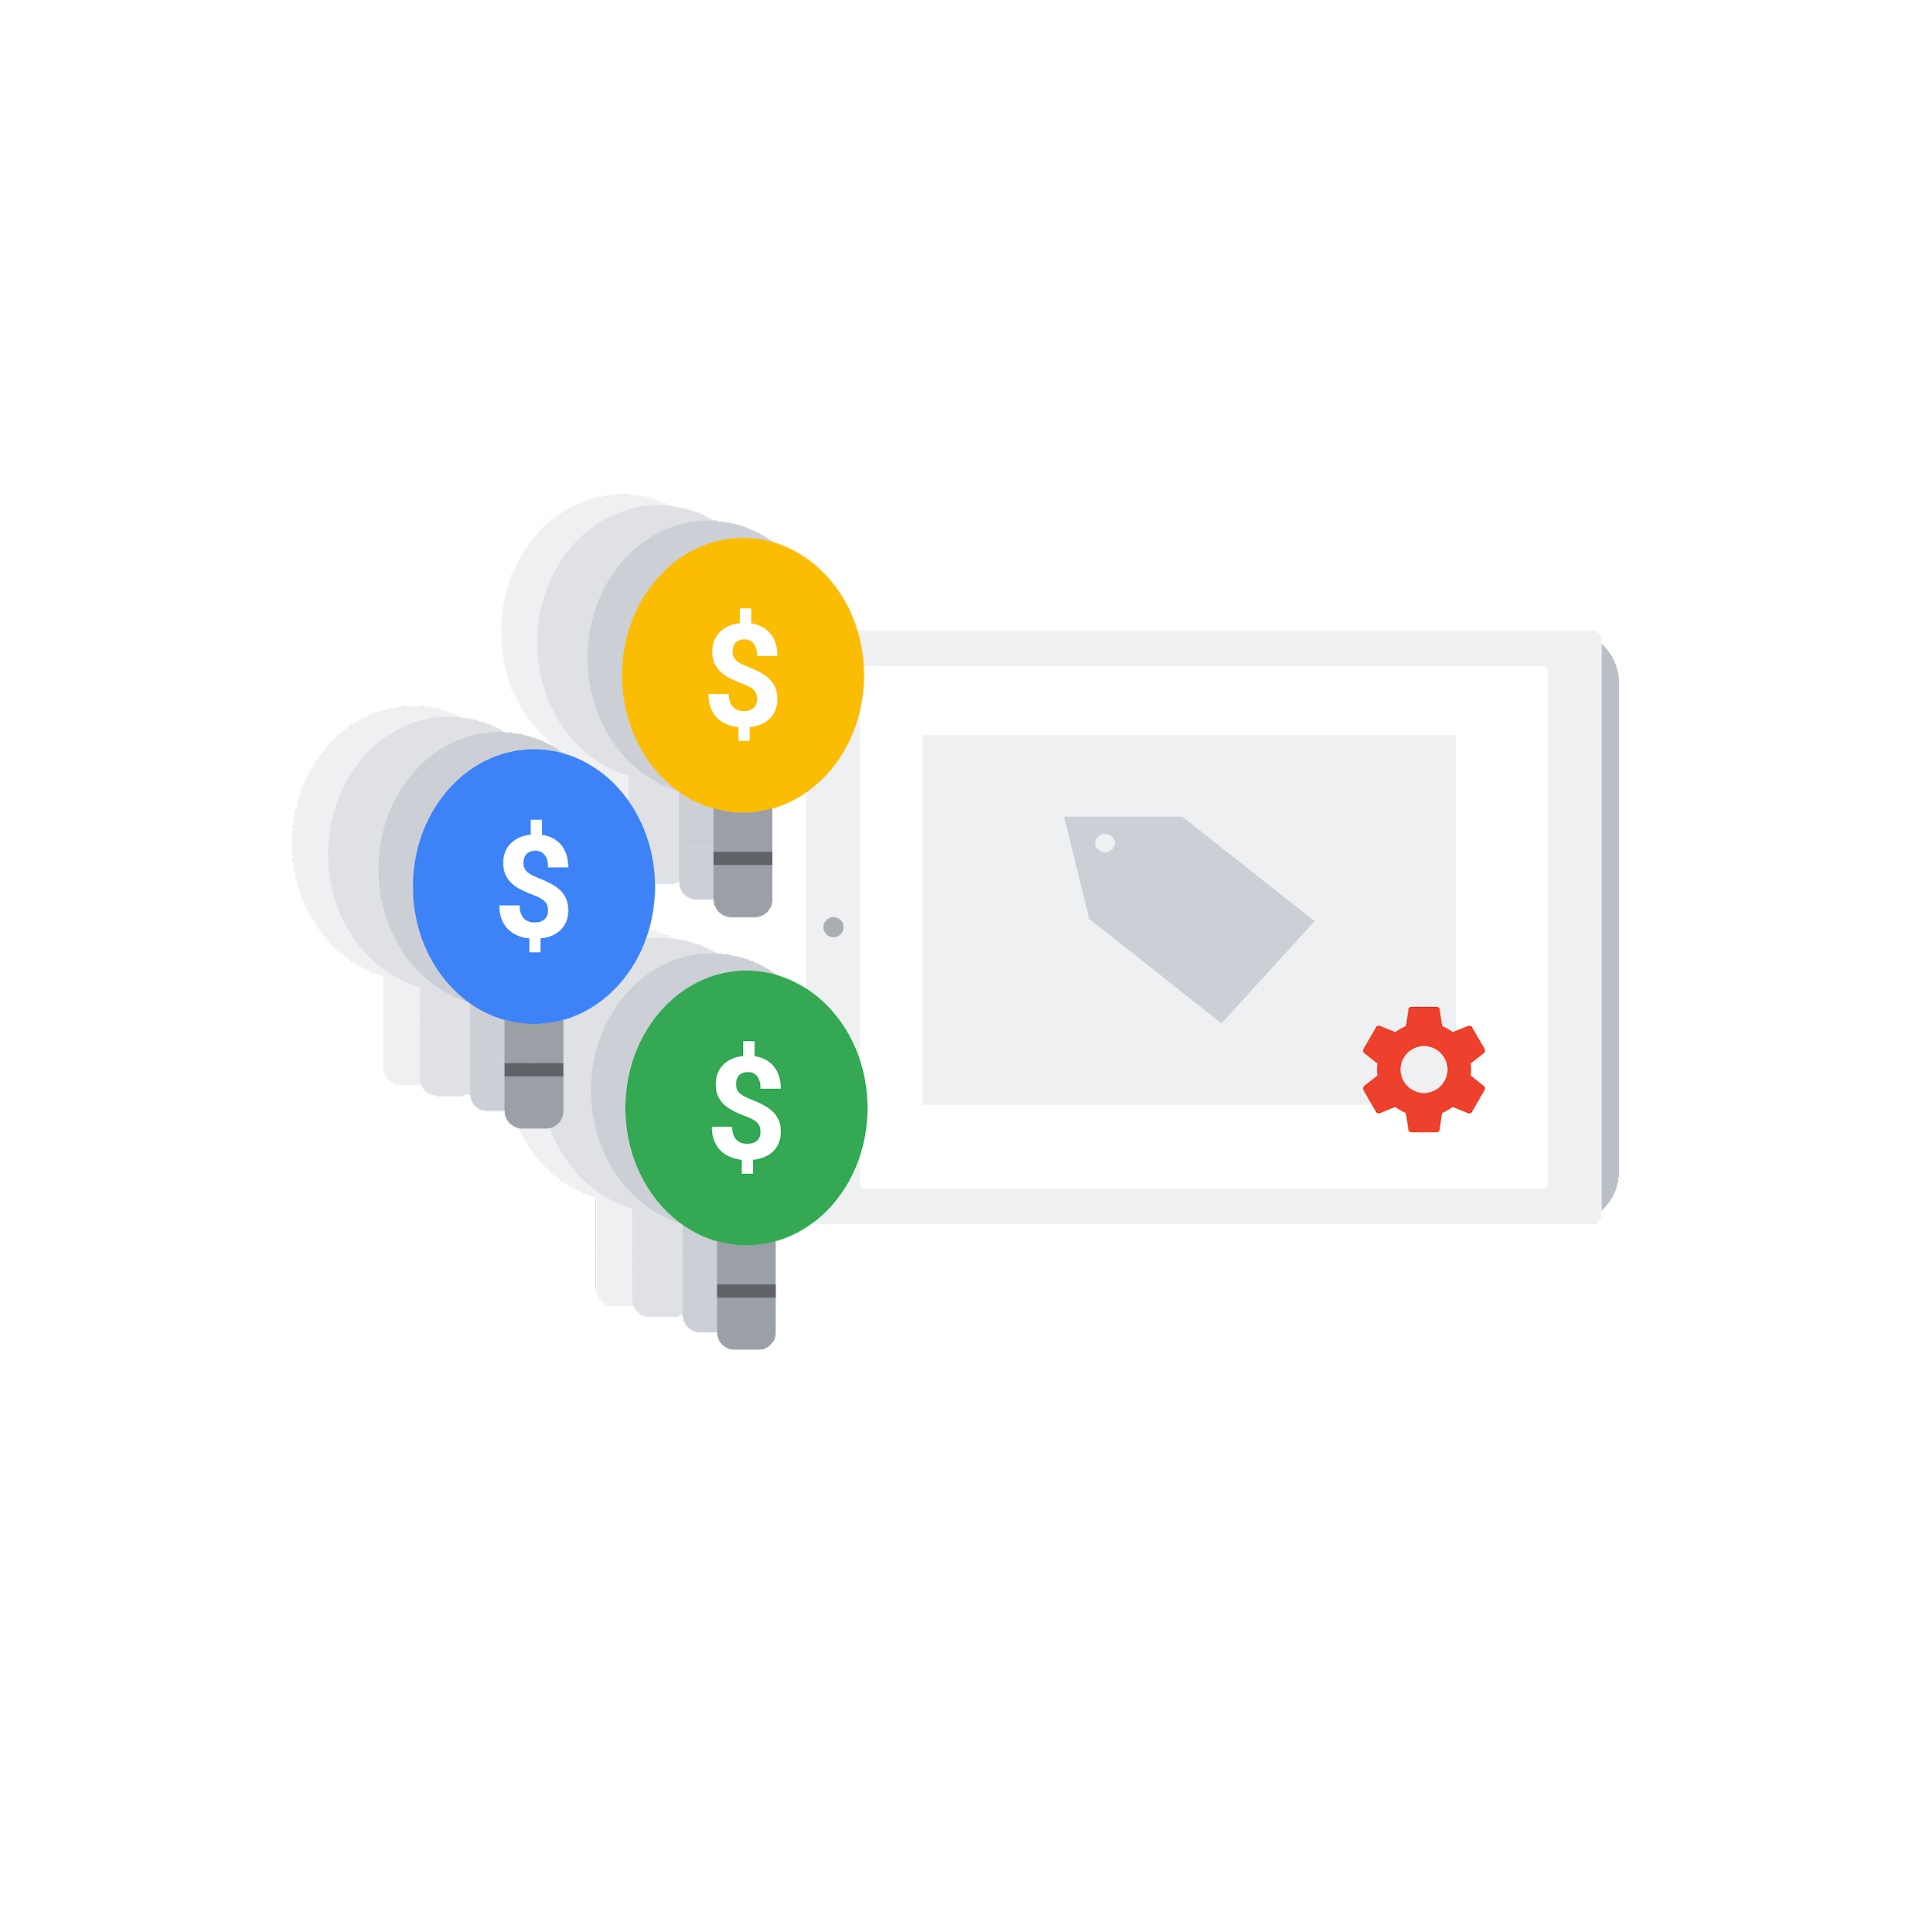

Current Marketing
Current Ad Grants Campaigns
Fundraising Events
Mothers Brunch Tea & Me Picnic May 18th Community Youth & Family Day Buddy & Me Cookout June July Open House
Opportunities
Social Media Marketing
Partnerships
Public Relations
Notes:
Utilize platforms like Facebook, Twitter, Instagram, and LinkedIn to share your mission, engage with supporters, and promote events. These platforms offer free or low-cost advertising options to reach a wider audience.
Collaborate with other organizations, businesses, or influencers who share your values. Partnering can help amplify your message and reach new audiences without significant costs.
Reach out to local media outlets to share your story and mission. Press releases, interviews, and feature articles can help raise awareness about your organization at no cost.

Slide 12
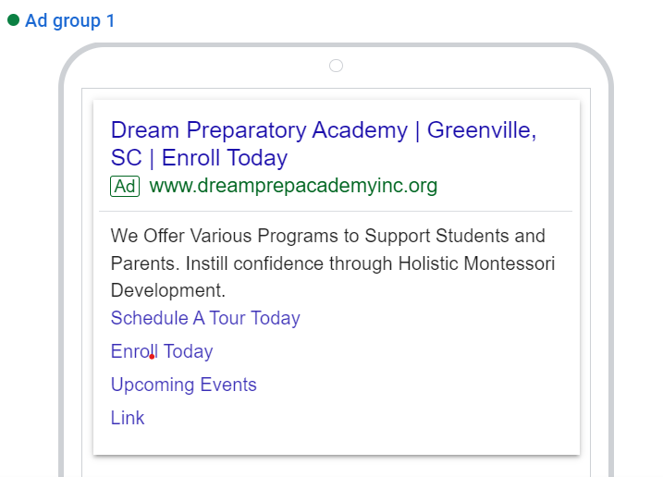
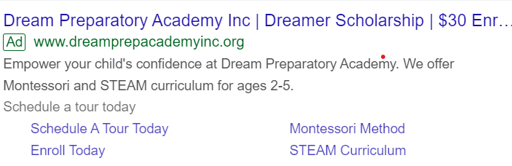
Current Google Ads Campaign
CAMPAIGN 1
CAMPAIGN 2
Impressions – 760 Clicks - 55
Impressions – 0 Clicks - 0
Top Search Words – Montessori, School, Near me, Greenville, Early Childhood
Keywords – childcare, montessori school, preschool, daycare, Childcare
Notes:
Mourya

Slide 13
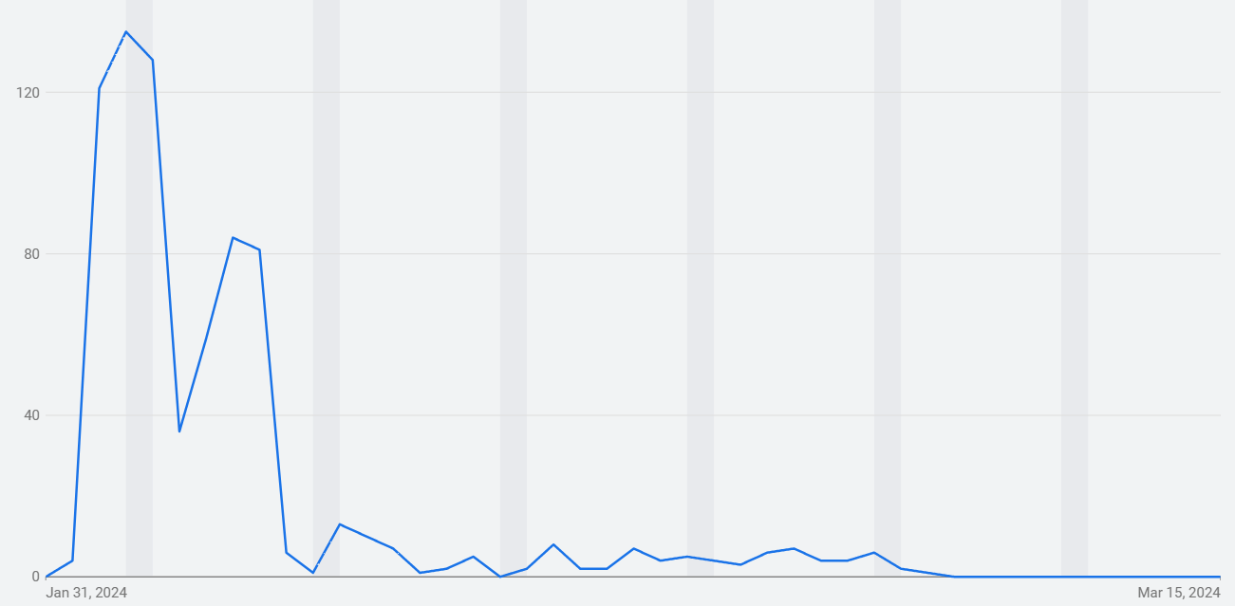


Current Account Performance
Impressions
Impressions Desktop: 326
Impressions Mobile: 428
Impressions from Jan 31, 2024 to May 15, 2024.
{{Image or graph, perhaps showing recent account performance trends}}
Clicks
Clicks Desktop: 31
Clicks Mobile: 24
Clickthrough rate (CTR)
CTR Desktop: 9.51%
CTR Mobile: 5.61%
Conversions/Conversion Rates
Conversions over the past 30 days: 0%
Conversion Rates: 0%
Notes:
Mourya

Slide 14
Nonprofit Marketing Goals
Improve Enrolment
Current enrolment is at zero
Targeted enrolment is 20
Improve reach
Current impressions for 2 months are at 760
Localized targeting
Promote Events
Current fundraising events:
Mothers Brunch Tea & Me Picnic
Community Youth & Family Day
Buddy & Me Cookout June
July Open House
Notes:
Gina

Slide 15
Proposed Strategies to Achieve these Goals
Improve Enrolment
Improved CTR
Improved Ad relevance
Service offerings
Improve reach
Higher Bidding budget
Higher number of keywords
Promote Events
Integrate the events into ad content

Slide 16
Proposed Strategies to Achieve these Goals
Create Awareness
1.Target Relevant Keywords 2.Compelling Ad Copy 3.Localized Targeting
1.Donation-Specific Campaigns 2.Compelling Calls-to-Action 3.Keyword Variations
Increase Donations
Recruit Volunteers
1.Volunteer Recruitment Campaigns 2.Action-Oriented Messaging 3.Long-tail Keywords
Promote Events
1.Event-Specific Campaigns 2.Event Extensions 3.Event-related Keywords
Notes:
Mourya/Utkarsh

Slide 17
Account Performance Metrics and Goals
Key Metrics | Current (“Pre”) 01-31-2024 to 03-29-2024 | Target Goal | How
CTR % | 7.24% | maintain | Improving the absolute number of clicks is the primary priority right now
Conversion Rate | 0% | NA | Conversion is dependent on multiple factors incl. the actual services being offered, website performance, etco y
Ad Quality Score | 4-5 | 10 | Improving keywords, Keyword segmentation into different ad groups
Total spending per day | $ 3 | $ 300 | Increasing absolute number of keywords
Avg Cost per click | $ 3.80 | In line with spend | Strategize based on not-to-exceed total spend of $ 300 per day
Notes:
Education industry avg: 4-5 %

Slide 18
Campaign Weekly Plan Summary
Start Date: Feb 22, 2024
End Date: Apr 26, 2024
Week 1 | Week 2 | Week 3 | Week 4 | Week 5 | Week 6 | Week 7 | Week 8
Strategy
>Kickoff Meeting
>Identify & agree on:
Number of campaigns
Keyword strategy
Goals
Success metrics
Strategy
Campaign 1 Prep
Campaign 1 release
Start collecting performance data
Campaign 1 keyword analysis
Strategy
>Improvement suggestions & implementation
> Closing Meeting
Notes:
Utkarsh

Slide 19
Why a new campaign
Keywords:
More keywords
Keyword relevance
Ad Quality:
Better ad design (content & real estate)
Separate Ad for each keyword trigger
Campaign tracking: It’s easier to track a new campaign
Notes:
Very few keywords: can increase as we have more budget
Relevance: Can find out more highly relevant keywords
Segmentation: Previous campaign had one ad group containing all the keywords, separate ads for each keyword trigger can improve
Ad design: improvement: relevance, content: keyword specific ads (separate ads for separate keywords), ad real estate: add assets like promotions, prices, contact details, lead forms, etc.

Slide 20
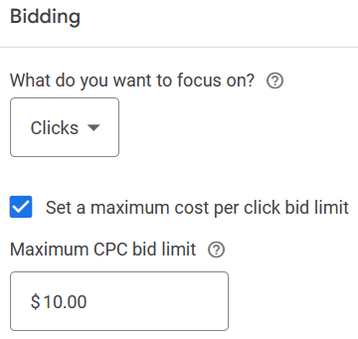
Bidding
Understanding our Options:
Conversions
Conversion value
Clicks
Impression Share
Our Choice: Clicks
Rationale behind the choice:
Market presence
Website conversions
Visibility
Notes:
Market Presence: Explain that the NGO aims to increase its market presence due to its recent inception.
Website Conversions: Mention that the current conversion rate through the website is low, making it an unsuitable metric for campaign success at this stage.
Visibility: Emphasize the need for high visibility to enter and establish a position in the market.

Slide 21
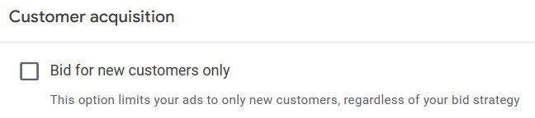
Customer Acquisition
Understanding our Options:
Only new customers
Both old and new customers
Our Choice: Both old and new customers
Rationale behind the choice:
Education sector
Value of revisits
Loss of customers
Notes:
Education Sector Insights: Highlight the unique behavior of customers in the education industry, such as the tendency to revisit websites multiple times to explore various options.
The Value of Revisits: Explain that revisiting is a crucial part of the decision-making process in education, indicating a high level of interest and engagement.

Slide 22
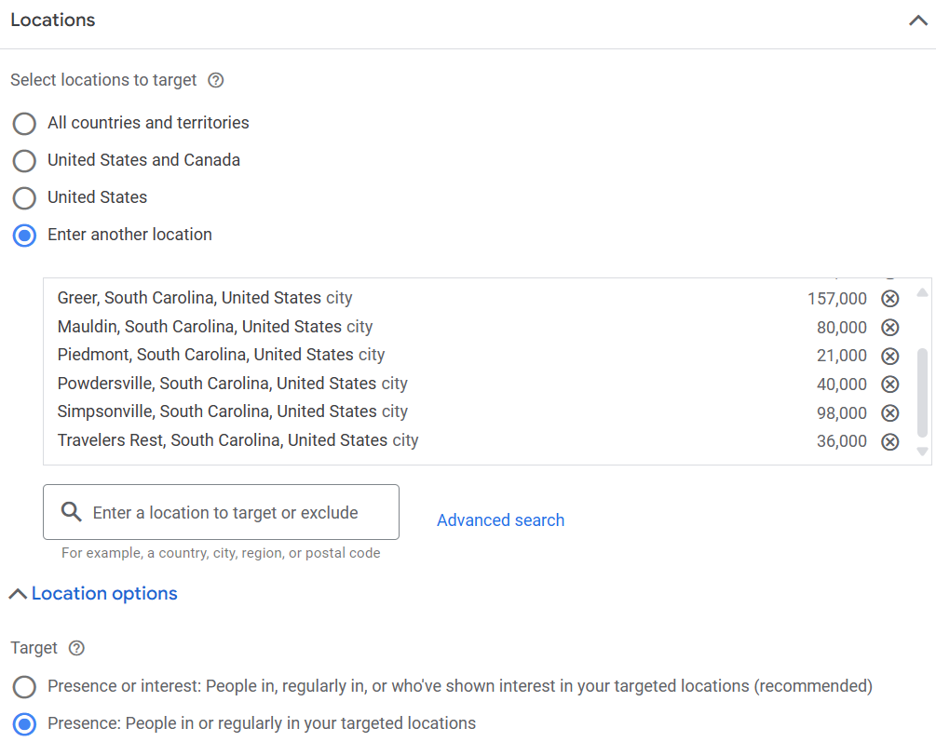
Locations
Focus Locations:
Areas in and around Greenville
Why go local?
Narrow focus
Cost vs Quality
Target: Presence
Interest vs Reality

Slide 23
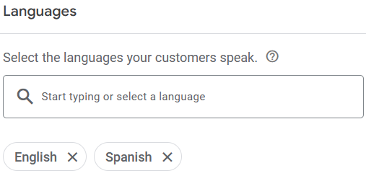
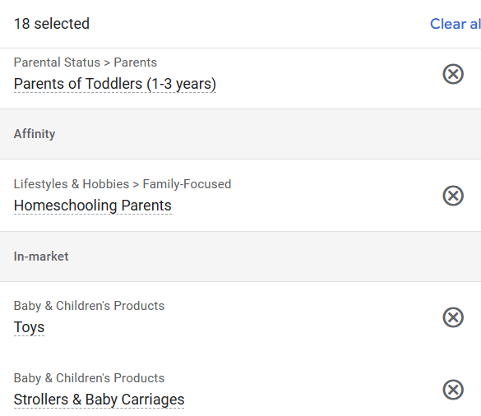
Languages and Audience Segments
Languages
English
Spanish
Audience categories of Segments:
Based on Demographics
Based on their affinity
Based on their active research
Custom Segment
Notes:
Pratiksha

Slide 24
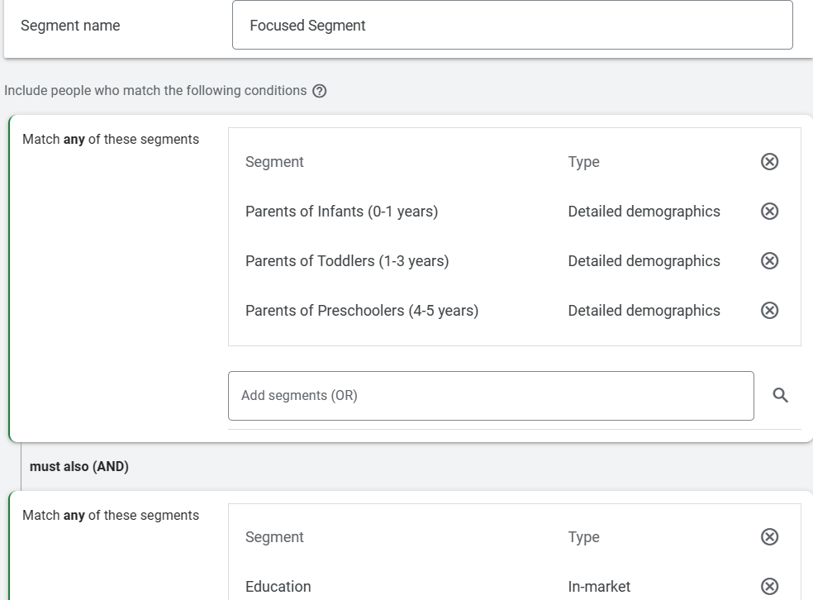
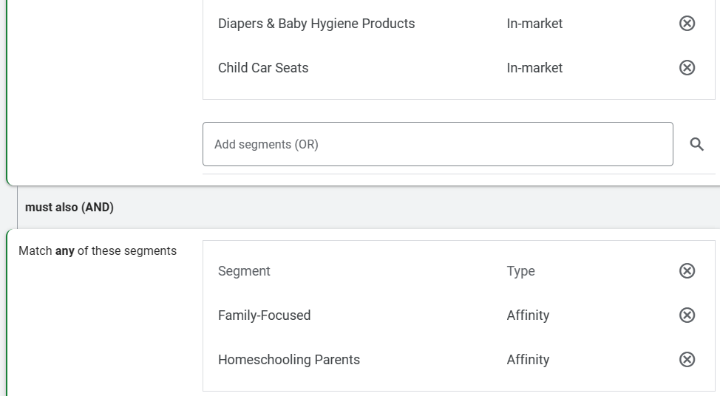
Custom Audience Segment
Power of Combination: Focused segment
Example:
Parents of toddlers (1-3) years with affinity towards ads related to family-focused and are actively searching for educational toys
Expected Outcome:
Increased ad relevance
Better engagement rates
Higher conversion probabilities
Notes:
Pratiksha

Slide 25
Keywords addition and Ads Creation

Slide 26
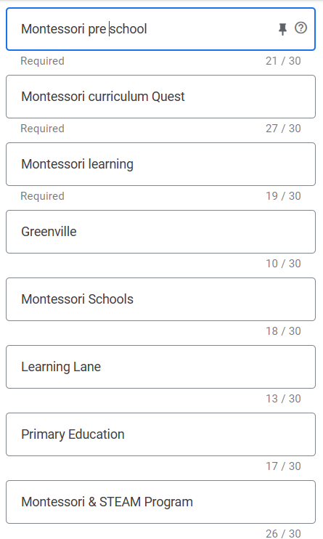
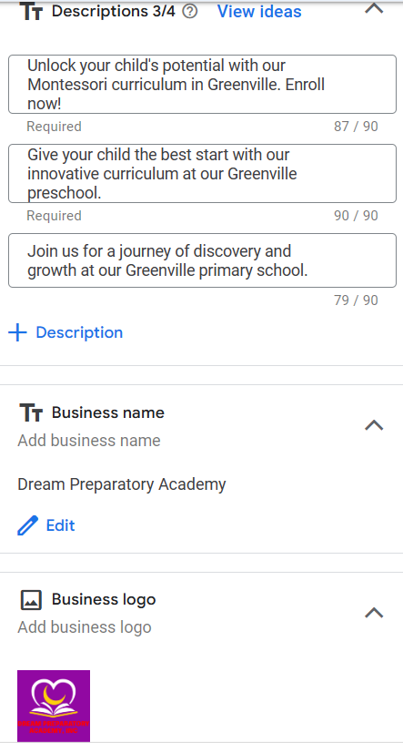
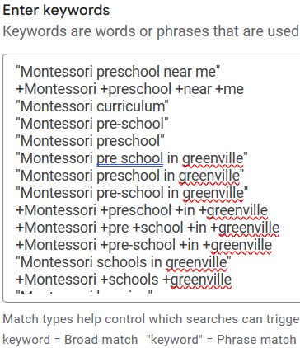
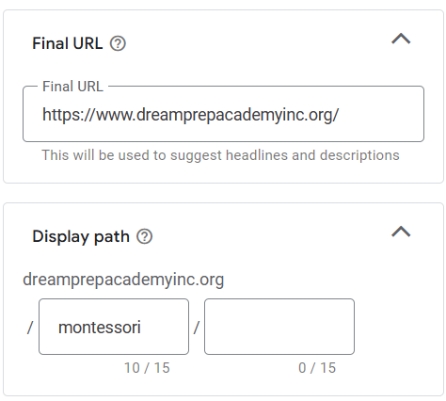

Slide 27
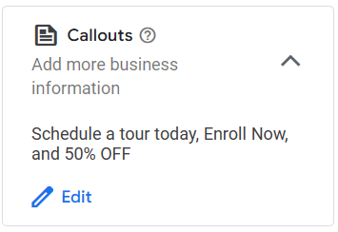
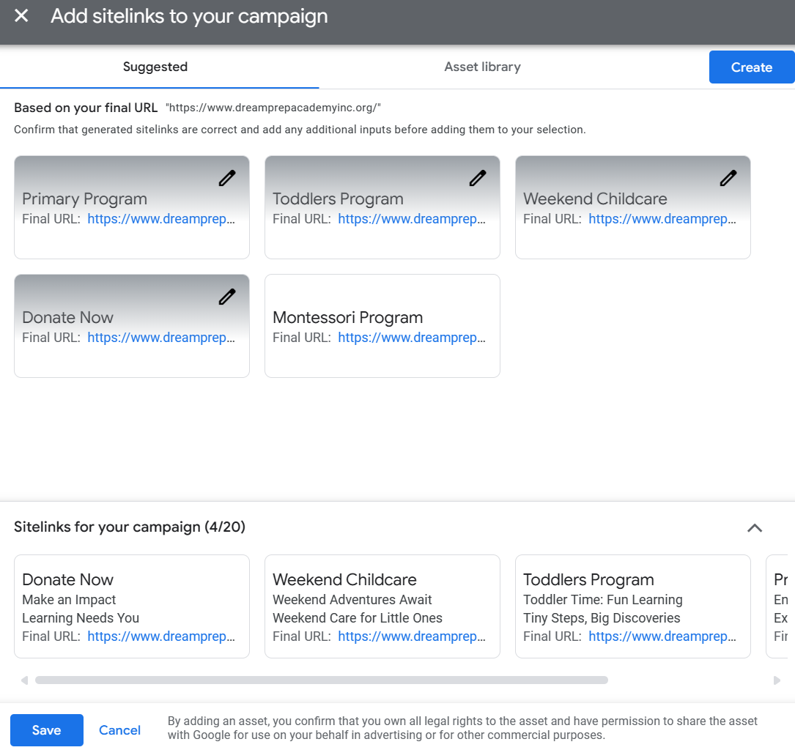
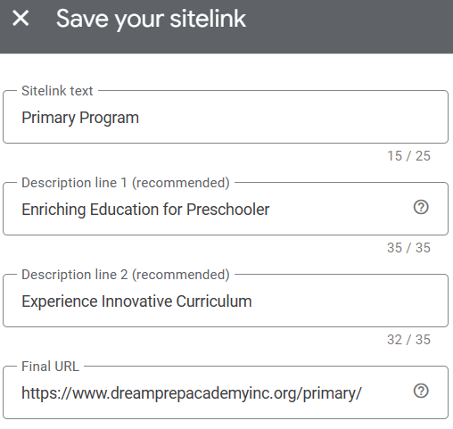
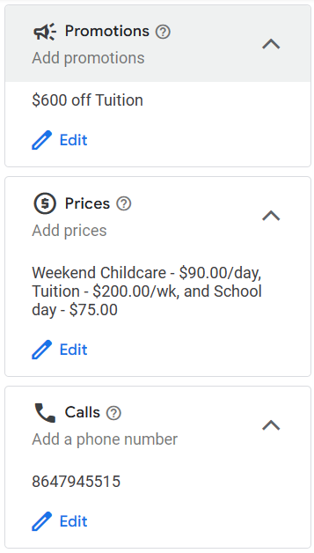

Slide 28
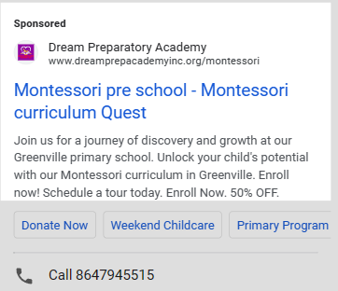
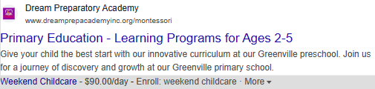
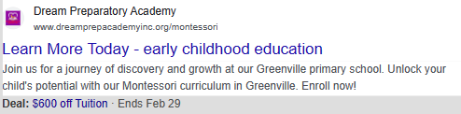
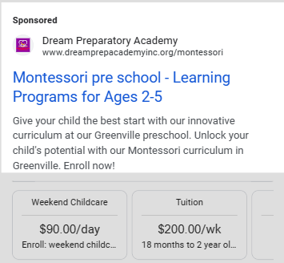
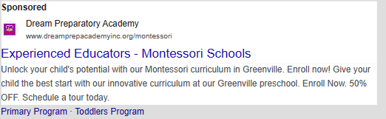

Slide 29
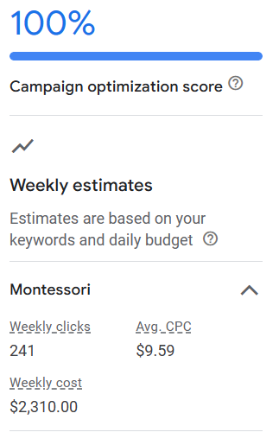
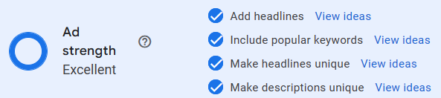

Slide 30
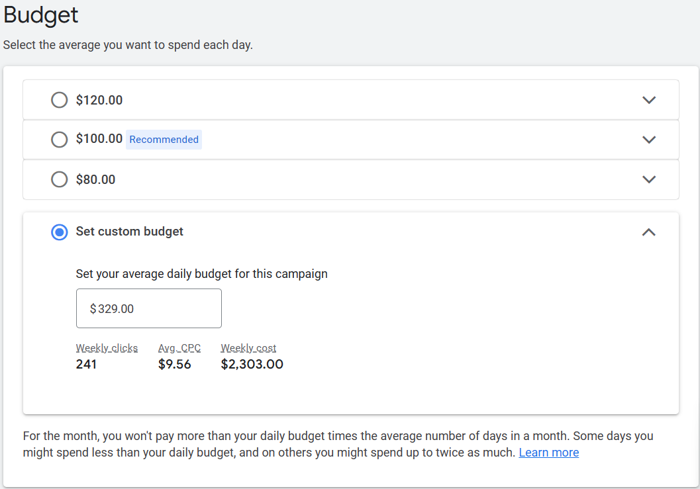
Budget
Budget Limit:
Google Ad Grants accounts are limited to a monthly budget of 10000$.
Custom Budget: 329$ daily
Notes:
Pratiksha

